Slide 1
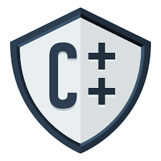
CSE202 OBJECT ORIENTED Programming

Slide 2
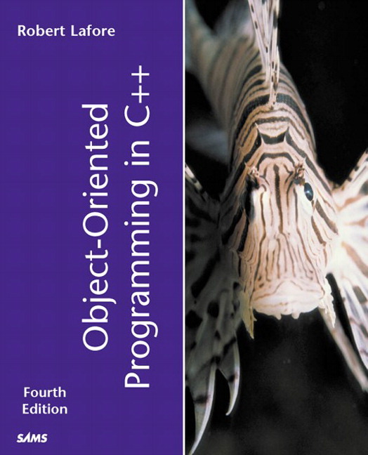
Course Details
[Five Hours/week]
Text Book
“OBJECT ORIENTED
PROGRAMMING IN C++”
by
Robert Lafore
L | T | P
3 | 0 | 2

Slide 3
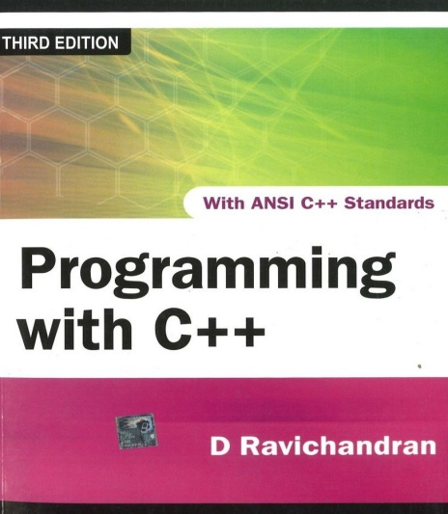
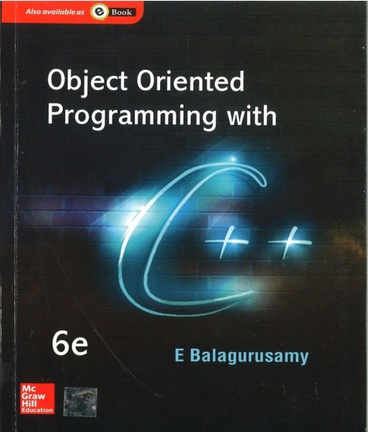
Reference Books
PROGRAMMING WITH C++
by
D RAVICHANDRAN
OBJECT ORIENTED
PROGRAMMING IN C++
by
E BALAGURUSAMY

Slide 4
Course Outcomes
CO1 :: identify basic programming constructs and use the newly acquired skills to solve extensive programming problems.
CO2 :: discuss the mechanism of code reusability by creating own libraries of functions.
CO3 :: validate the logic building and code formulation by designing code capable of passing various test cases.
CO4 :: interpret the principles of the object-oriented model and apply it in the implementation in C++ language.
CO5 :: develop accurate, reliable and efficient software applications.
CO6 :: apply the knowledge acquired to develop software applications

Slide 5
Course Assessment Model
Marks break up
Attendance 5
Academic Task 50 (30+20)
ETE 45
Total 100

Slide 6
Academic Task
Component Week
Test 1 5th
Test 2 10th
Test 3 12th

Slide 7
CA
Programming Practice using IamNeo Platform
Best 2 out of 3 Academic Task
Programming practice is a compulsory requirement
50
ETP
Will be conducted on IamNeo Platform

Slide 8
Academic Task
Each Academic task will contain 2 coding questions and 10 MCQs
The weightage of programming practice which is spread across 150 problems with 25 problems per unit will be 20%.

Slide 9
CA Marking Scheme
In order to qualify for programming practice marks, the student should solve at 50% problems (eligibility condition).
In case the student scores more than or equal to 81% in all the CA’s [Best 02 are to be taken from 03] then he/she will be eligible for obtaining 100% of the marks awarded as 1mark allocated for every 5 problems correctly solved after the mandatory first 50% problems capped with a maximum score of 20.
71% - 80% in all the CA’s [Best 02 are to be taken from 03]→ 70% of the marks awarded.
51% - 70% in all the CA’s [Best 02 are to be taken from 03→ 50% of the marks awarded
30% - 50% in all the CA’s [Best 02 are to be taken from 03]→ 30% of the marks awarded
If a student has scored less than 30% in the CA’s [Best 02 are to be taken from 03], then he/she will not be eligible for any benefit

Slide 10
Why a Star Course?
This course Serves as the basis for the product based pathways
This course is a star course as it has direct bearing with the placements.

Slide 11

The hitch……
Some burning questions in mind......
Is C the only language behind the development of all these powerful softwares
Why C++?
How C++ is different from C language?
Is there no scope of this language in industry?

Slide 12



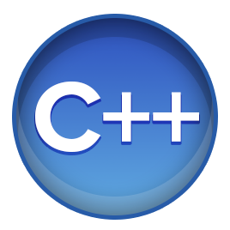
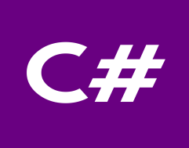

Flashback………..
What C language can do?????
Device drivers are written in C language.
All these modern programming languages are influenced by C language
Compilers for Python and PHP language are also written in C language
Embedded systems are also developed with the help of C language

Slide 13

Is C only language?????
Lets answers your questions
No, C is not the only language for the development of all these powerful system
If we talk about Windows operating system, only Kernel is written in C language rest all other features are provided with the help of C++ language

Slide 14
How does it differ from C
C uses top down approach for problem solving
There are no means of providing security.
C doesn't support inheritance, makes it more complex to use because everything has to be written from scratch.
C is not able to represent real world modelling

Slide 15












No scope of language in Industry
Top rated Companies which has a dearth of C++ programmers

Slide 16
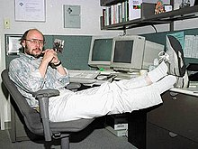
Introduction to C++
In 1979, Bjarne Stroustrup, began work on "C with Classes”
The motivation for creating a new language originated from Stroustrup's experience in programming for his Ph.D. thesis.
Stroustrup found that Simula had features
that were very helpful for large software
development, but the language was too
slow for practical use, while BCPL was fast but
too low-level to be suitable for large
software development.

Slide 17
Q1
Major objective for C++ is to:
A. Represent real world entities in the form of objects
B. Implement procedural approach
C. Implement top down approach
D. Implement functional programming

Slide 18
Q2
Initial name of C++ was:
C++ with classes
C with classes
Objects with C++
C with objects

Slide 19

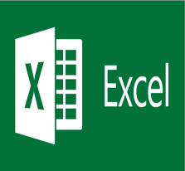





Applications
Git
 | Microsoft Excel
Oracle Database
 | MySql
Linux
 | Unix
Android
 | Google

Slide 20
WHY C++?????
Lets see

Slide 21
Key features of C++
Object and Classes
Real world modelling
Encapsulation
Wrapping
Data Abstraction
Hiding of non required information
Inheritance
Reusability

Slide 22
Key features of C++
Polymorphism
Many forms
Data Hiding
Security
Message Passing
Communication

Slide 23

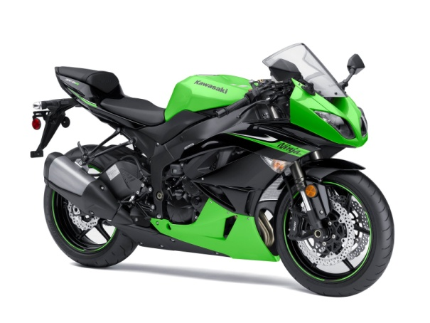
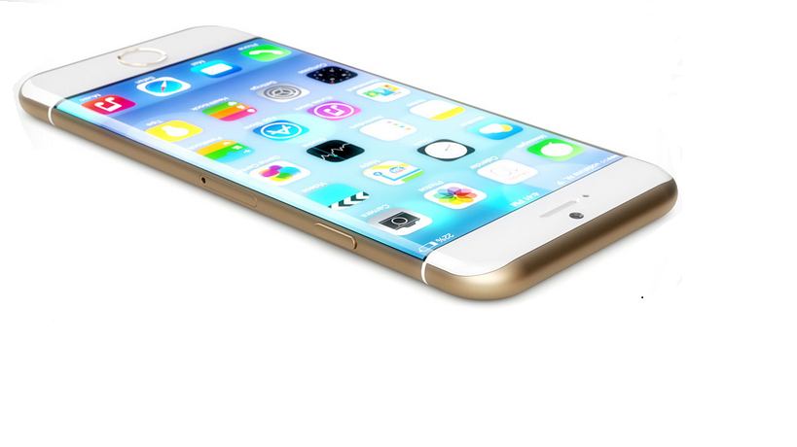

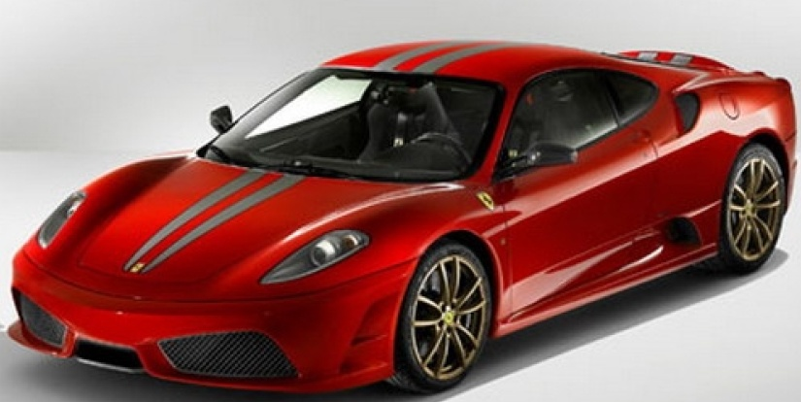

(Objects)Daily Analysis
Look around you and identify some objects
Everything is an OBJECT

Slide 24
Object ,Object and Object
A student, a professor
A desk, a chair, a classroom, a building
A university, a city, a country
A subject such as CS, Math, History, …

Slide 25
Procedural Approach(C Language)
Focus is on procedures
All data is shared: no protection
More difficult to modify
Hard to manage complexity

Slide 26
Data is not secure……..
FUNCTION 1
DATA 1
FUNCTION 2
DATA 2
FUNCTION 3

Slide 27
Object Oriented Approach
Emphasis is on data rather than procedure
Programs are divided into what are known as objects
Data is hidden and cannot be accessed by external functions
New data and functions can be easily added whenever necessary

Slide 28
MEMBER
FUNCTIONS
DATA
MEMBER
FUNCTIONS
DATA
MEMBER
FUNCTIONS
DATA
OBJECT ORIENTED APPROACHABSTRACTION & ENCAPSULATION

Slide 29
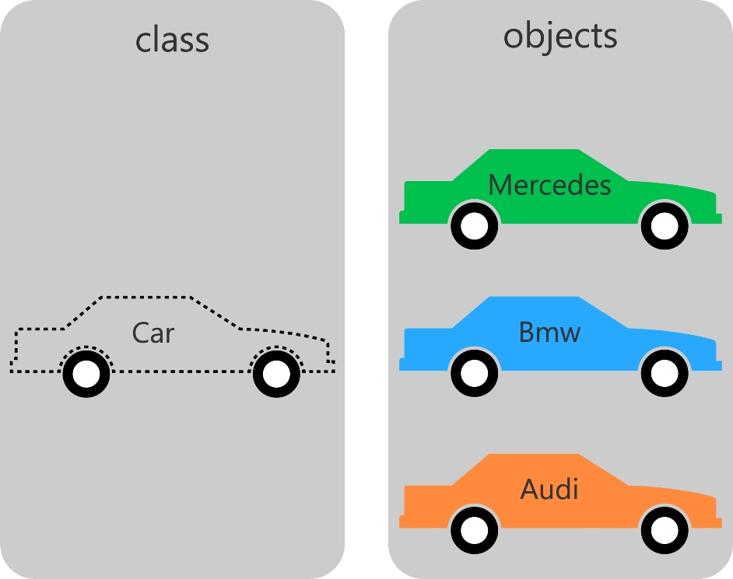
Classes and Objects(Example 1)

Slide 30
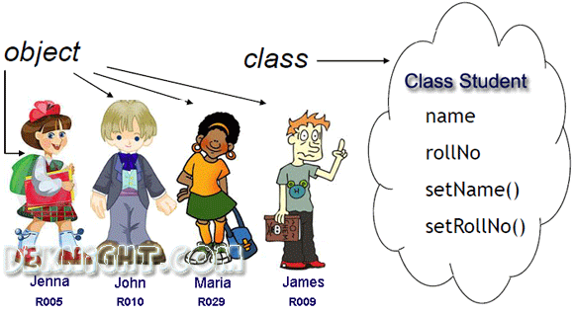
Classes and Objects(Example 2)

Slide 31
Classes and Objects
A class is a prototype or blueprint for creating objects
When we write a program in an object-oriented languages like C++,Java, we define classes, which in turn are used to create objects

Slide 32
Classes and Objects(Technical Example)
class
Time
inTime
hour
minute
void addMinutes( int m )
Attributes: hour = 8 minute = 30 Methods: void addMinutes(int m)
outTime
Attributes: hour = 17 minute = 35 Methods: void addMinutes(int m)
objects

Slide 33
History of Object-Oriented Programming
Started out for simulation of complex man-machine systems, but was soon realized that it was suitable for all complex programming projects
SIMULA I (1962-65) and Simula 67 (1967) were the first two object-oriented languages
Developed at the Norwegian Computing Center, Oslo, Norway by Ole-Johan Dahl and Kristen Nygaard
Simula 67 introduced most of the key concepts of object-oriented programming: objects and classes, subclasses (“inheritance”), virtual procedures

Slide 34
The Ideas Spread
Alan Kay, Adele Goldberg and colleagues at Xerox PARC extend the ideas of Simula in developing Smalltalk (1970’s)
Bjarne Stroustrup develops C++ (1980’s) at AT &T Bell Labs in Murray Hill, New Jersey, USA
Brings object oriented concepts into the C programming language
Earlier name was C with Classes
Later in 1983 the name changed to C++(The idea of ++ is taken from the increment operator of C)
In 1997, the ANSI/ISO made changes into the language and it was standardised

Slide 35
Features Continued…
Encapsulation
Abstraction
Reusability
Inheritance
Polymorphism

Slide 36
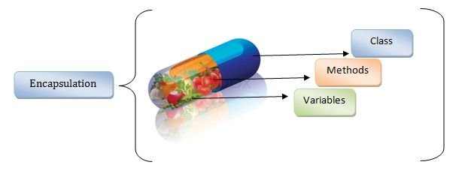
Encapsulation

Slide 37
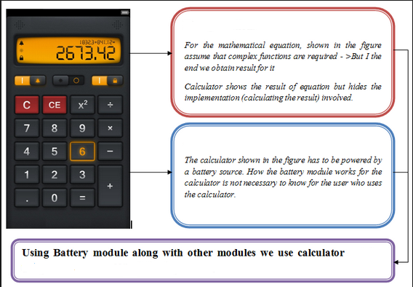
Abstraction(Hiding Details)

Slide 38
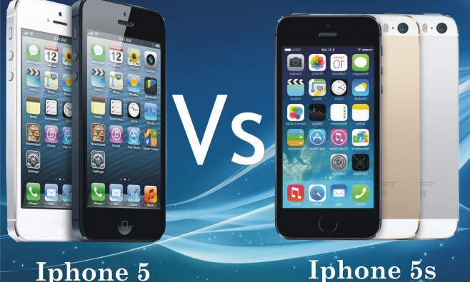
Reusability
Existing Features
Existing Features + Additional Features

Slide 39
Inheritance
But Mummy, where did my blue eyes come from?

Slide 40
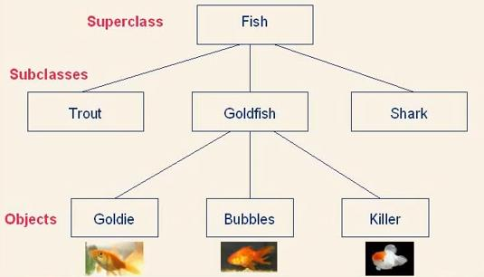
Inheritance….

Slide 41



Polymorphism
In front of father
In class
In CCD
One thing and many forms

Slide 42
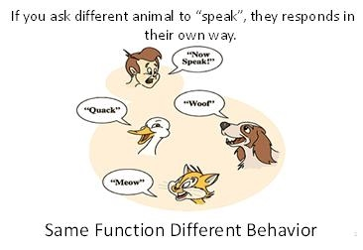
Polymorphism
Ability to appear in many forms…

Slide 43
Course Contents
Classes and Objects | Operator Overloading
Functions | Type Conversion
Pointer Array String | Inheritance DMA Polymorphism
Constructor and Destructor | Exception Handling
File Handling | Templates and STL

